Slide 1
Stublib as interface
Header objects .ho
Will Denissen
Senior SW architect
Veldhoven

Slide 2
Proof of Concept
This PoC demonstrates how stublibs (a.k.a. header objects .ho) can be used to:
- Represent a stand-alone versioned interface
- Solve cyclic symbol/library link dependencies
- Detect and deduplicate identical types
- Check on compilation/linking errors/warnings against the used interfaces
- Control scope of data, functions, and types(imported, passed, exported, and internal).
- Develop a more modular SW product in parallel.
- Become independent of file system layouts (e.g. include and library search paths)

Slide 3
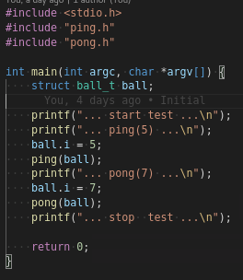
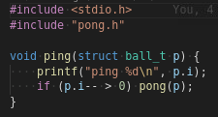


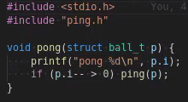
Problem
How to develop this together, fast and correctly?
Cons:
Cyclic type/sym/lib dep.
Types:
Shared types.
Type deps.
Work breakdown.
IP protection
File system deps
Keep .c ←→ .h aligned
libping.so
mytest
libpong.so

Slide 4
Solution
Use stubs as provided/required interface contracts
.
Cons:
Cyclic type/sym/lib dep.
Types:
Shared types.
Type deps.
Work breakdown.
IP protection
File system deps
Keep .c ←→ .h aligned
pong.ho
Pro:
Interface
ABI level (more detail)
Versioned/Portable/Diffable
Tools
processable
Simple IDE
ping.ho
pong.ho
ping.ho

Slide 5
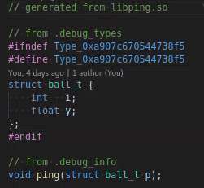
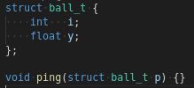
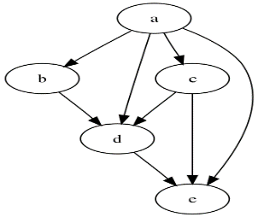
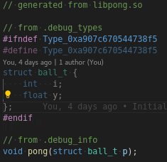
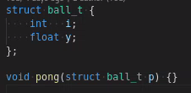
How?
Generate .ho as provided/required interface contracts
compile -g
stub2hdr.py
ping.ho
pong.ho

Slide 6
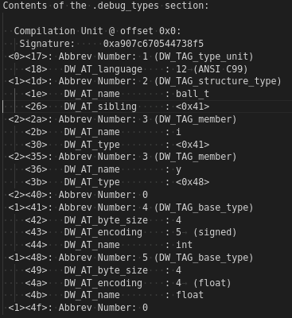
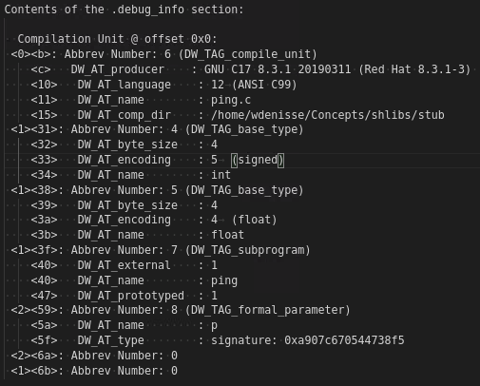
Feasible?
Implement stub2hdr.py tool (by extending pyelftools)
ping.ho
stub2hdr.py
Pro:
Single Point of Definition (SPOD)
All type/func/var info available
Standard encoded (DWARF)
Supports 40+ languages
ELF/Dwarf tools available
3rd party libs can be turned into stublibs
Independent of packaging (.o, .a , .so)
Con:
stub2hdr.py does not yet exist
GitHub - eliben/pyelftools: Parsing ELF and DWARF in Python

Slide 7
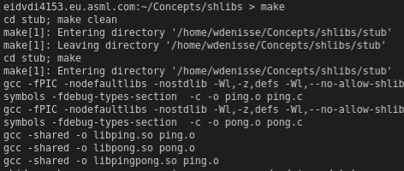
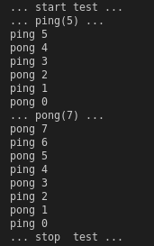

Conclusion
Yes! We can develop this together, in parallel and with quality!
Parallel workflow
Build stubs
Together
Run
ping.ho
pong.ho
Extract headers
stub2hdr –o ping.h ping.ho
stub2hdr –o pong.h pong.ho
Quality
ping.h
pong.h
Note: ping.h and pong.h are manually created
Parallel
Build implementations
includes
mytest
libping.so
libpong.so
Compile/Link against stubs

Slide 8
Spinoff
Short-term

Slide 9
Short-term
No more “Interface dealing”
#??? .h(pp) symlinks to other .h(pp) disappear in xifs directories
Being ???% of all #??? build targets
Same cleanup can be done for modular interpreted languages
Python stub files .pyi are the python header object files
No filesystem layout replication needed due to #include “<path>/file.h”
Scope file can be cleanup wrt. dealing keywords
All symlink build rules will disappear in Bazel BUILD files
Avoids explanation to SW developers if they weren’t

Slide 10
Short term
No more …
…
…

Slide 11
Spinoff
Long-term

Slide 12

Long term
Tangible SIAs: results in a feature skeleton
Feature skeleton
Feature skeleton
Pro:
Parallel workflow
Package definition (boundaries) before
Package implementation (internals).
Simple work breakdown/roles
Boundaries (SW architects)
Internals (SW developers)
Simple scope/evolution control enforced by tools
Backward/Forward compatible checks
Exported/Imported/Internal types/functions/variables
Evolution (SW Impact Analysis SIA)
Header objects also work for interpreted modular languages
<pro1>.ho
<pro2>.ho
Baseline
<req1>.ho
<req2>.ho
Feature implementation

Slide 13
Long term
Compositions at all levels Executable/CC/BB/ASS
BB skeleton
Pro:
Parallel workflow
Package definition (boundaries) before
Package implementation (internals).
Simple work breakdown/roles
Boundaries (SW architects)
Internals (SW developers)
Simple scope/evolution control enforced by tools
Backward/Forward compatible checks
Exported/Imported/Internal types/functions/variables
Evolution (SW Impact Analysis SIA)
Stub interf. also work for interpreted modular languages
Con:
More (bin)utils need to be developed
CC skeleton
CC skeleton
BB skeleton
CC implementation
CC implementation

Slide 14
Long term
Scope control
Header objects allow full control:
on compositions (assemblies, BBs, CCs, executable)
on symbols (imported/internal/exported types/variables/functions)
on evolution of symbols
on ownership of symbols

Slide 15
Long term (23Q1)
From Monolith + breakout → Hybrid builds
ccmake
ifs
xifs
gradle
bazel
ccmake
gradle
bazel
Sync dependency
Repository
Def use dependency

Slide 16
Long term
No more …
…
…

Slide 17
Will Denissen
Veldhoven
Senior SW architect
Will.Denissen@asml.com

Slide 18
Interface portability versus ClearCase
Scope files
Makefiles
What are stublibs and where are they used
In the Scanner ClearCase build we use the XIFS (Cross Interfaces) mechanism to control visibility and expose the headers and stubbed libraries of interfaces.
An interface is defined in Scope files.
A generation mechanism translates the interface definition to a stubbed library.
However, this mechanism has several caveats which greatly hinder modularity and build parallelism.
Mostly due to Non-Stubbed libraries (xNSLIB)
Also includes circular dependencies
Lastly the mechanism is build framework specific and tailored to the ClearCase build
Generated Makefiles
ACF and DDF Files
ddgen file generation
h2stub and h2stubcpp
How can we replace this with a solution applicable to all interfaces for all build systems based on common standards?
Stubbed library compilation

Slide 19
Interface portability versus ClearCase
How are stublibs propagated during the build
The overall XIFS directory holds symbolic links to all actual interfaces (/vobs/litho/xifs)
These entries are used to create more symbolic links on component level to the interface contents
The following directories are populated during build time and the contents are governed by Scope
/vobs/litho/BB/CC/xifs (contains links to all XIFS interface directories)
/vobs/litho/BB/CC/xlib (contains .so file symlinks, separated by target platform)
/vobs/litho/BB/CC/xtst (contains a mix of both the xifs and xlib conents including all header files from all allowed interfaces)
EMWA: Not ready
not sure what I want to explain here

